Slide 1


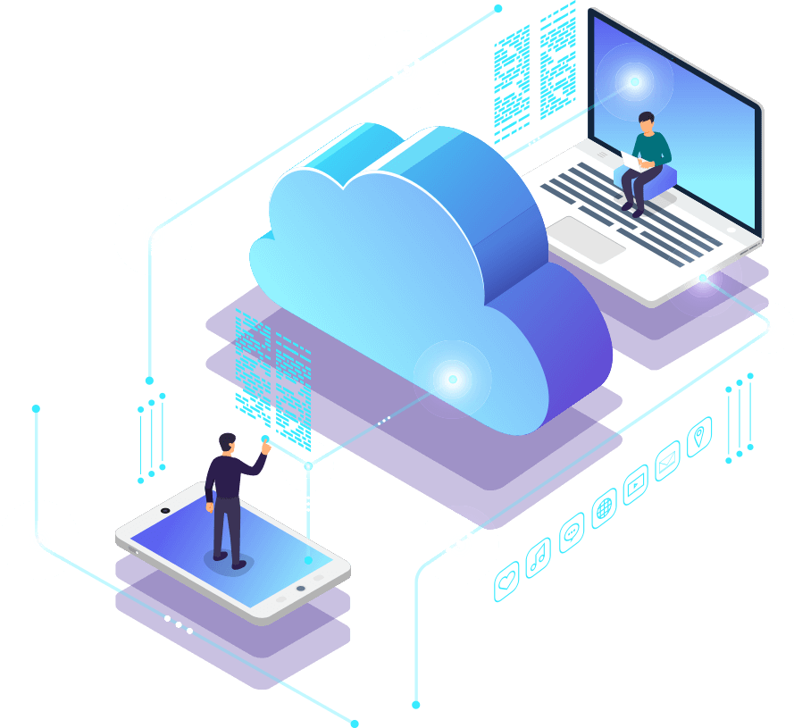
“Empowering Businesses Through Technology”

Slide 2

INTRODUCTION
Exordium Networks delivers innovative, secure, and dependable IT solutions that empower organizations to thrive.
Mission is to transform communication, connectivity, and care through advanced technology enabling seamless operations and future-ready growth.
Vision is to be the most trusted IT partner globally.

Slide 3




Our Leadership
Dr. Mohammed Khurrum
Abdeali Khurrum
Yasin Halai
CEO and President
Chief Technology Officer(CTO)
Specializing in IT Policy, Procedure Development, Disaster Recovery and Business Continuity
Chief Strategy Officer(CSO)
Resident ideation machine charged with keeping track of the myriad ways technology
Founder and the engine behind Exordium Networks, Mohammed’s mantra is “Business is done with People”

Slide 4






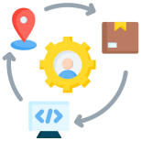


Service Portfolio
01
End-to-end IT solutions
(takeovers, consulting)
06
IT Infrastructure Projects
(Technology Transformation and
Infrastructure Migration)
02
Business Transformation & Consulting
07
Advance Cyber Security
(Comprehensive Cyber Defence
Strategies)
03
Advanced Wi-Fi & Telephony
(Smart Wireless Networking & Voice Communication Systems)
08
Microsoft 365 Administration
& Optimization
04
Back-Office Management
(Integrated HR, Finance, and
Payroll Services)
09
Infrastructure as a Service (IaaS)
(Empowering Growth Through Cloud-
Based Infrastructure)
05
Critical Care Technology Solutions
(nurse Call Systems & Pendant's)
10
24/7 remote IT helpdesk
(Reliable IT Help- Anytime, Anywhere)
Comprehensive IT Services

Slide 5









Market Challenges
Legacy systems create technical debt, security risk, and market disadvantage. Modernization Cyber security threats is not optional
Cyber security threats cost businesses billions annually.
Scalability issues hinder growth and innovation.
Outdated IT systems reduce productivity and increase downtime.
High operational costs impact profitability
Data Point “Global cybercrime damages projected to reach $10.5 trillion annually by 2025.”
Story Angle “Technology should enable growth, not create roadblocks.”

Slide 6








Customer Impact zones
Complex IT &
Vendor Landscape:
Security Risks
Operational Burden
Proactive cyber security solutions, including zero trust and ransom ware protection, safeguard your data and communications.
Streamlined back-office processes (HR, accounting) free up resources for core business priorities.
Multiple vendors for telecom,
IT, and security- Exordium
simplifies and integrates.
Scalability:
Critical Services:
Technology
Transitions:
Scalable infrastructure and cloud solutions support your organization's growth..
Reliable technology ensures high uptime for emergency systems and nurse calls.
Expert support for smooth migrations during mergers and upgrades.

Slide 7
Comprehensive Benefits
We deliver outcomes you can actually quantify, reduced downtime, faster deployments, higher ROI, improved security posture.
Cost Optimization is a continuous discipline to reduce expenses while improving operational efficiency and service quality.
Why Choose Exordium?
Enhanced Security refers to implementing advanced safeguards to protect people, data, systems, and infrastructure from evolving threats.
Business Continuity
Ensuring Stability • Minimizing Disruption • Protecting Operations
Achieve 99.9% uptime with managed services

Slide 8

Testimonials
What Our Clients Say:
“I was involved in the selection of Exordium Networks to manage our computer system and could not be happier with their performance. They have far exceeded our expectations. There is no comparison to any of the companies that we previously used
Michael Stoller
Managing Partner & CEO, LCB Senior Living
“Over the past 13 years, I’ve had the privilege of working alongside Mohammed Khurrum, and his team at Exordium Networks. When I started at Life Well, five years ago, I quickly recognized that we needed to make a shift from our existing provider to Exordium -
Kimberly Erickson
President & Chief Operating Officer, Life Well Senior Living

Slide 9









Why We Stand out
Managed Wi-Fi
Cyber security
E-Fax Services
Conclusion
02
04
06
08
VoIP Solutions
01
03
05
07
Infrastructure as
a Service (IaaS)
Virtual Desktops
BOM
Faster implementation than competitors
Lower cost of ownership
Certified experts with global experience
Proven track record with Fortune 500 clients

Slide 10

Managed Wi-Fi
High-speed, secure wireless connectivity throughout your facility
Segmented networks for residents, staff, and guests
Real-time monitoring and performance optimization.
Scalable infrastructure for expanding bandwidth needs
Compliance with HIPAA and regulatory standards

Slide 11

VoIP Solutions
Advanced features: Call Routing, Queuing, Recording, and Conference Calling.
Cloud-based system for remote access and scalability.
Integrated with telemedicine and emergency response systems.
24/7/365 support and monitoring for uninterrupted service.

Slide 12
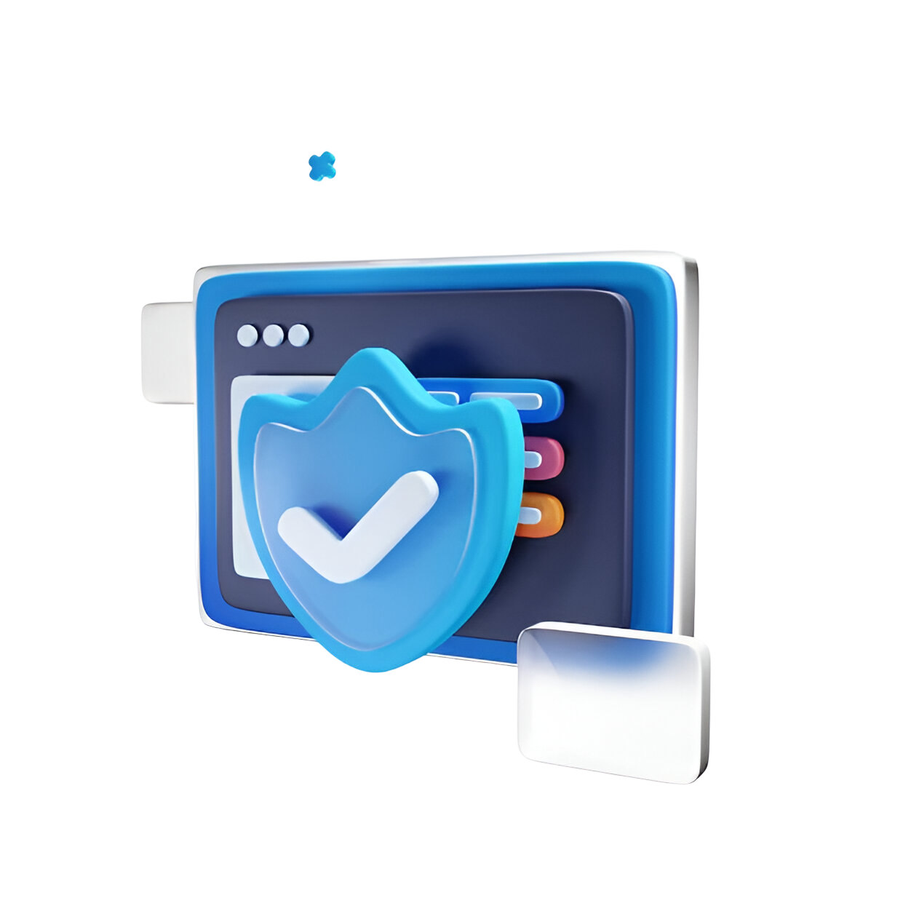
Cyber security
Comprehensive protection against malware, phishing, and ransom ware.
Advanced firewall and intrusion detection systems
Regular vulnerability assessments and penetration testing.-
Employee training and awareness programs.
Compliance with healthcare data protection regulations.

Slide 13
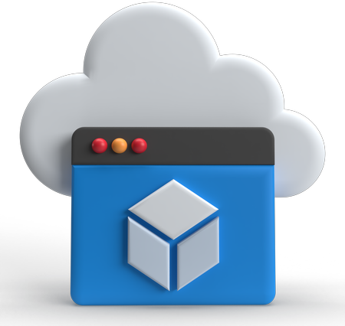
Virtual Desktops
Secure, cloud-hosted desktop environments for staff.
Access from any device, anywhere.
Centralized management and updates.
Enhanced data security and reduced endpoint risks
Cost-effective and scalable solution

Slide 14

E-Fax Services
Digital faxing without physical machines.
HIPAA-compliant transmission of sensitive documents.
Accessible via email or secure web portal.
Reduced paper usage and operational costs.
Audit trails and delivery confirmations.

Slide 15
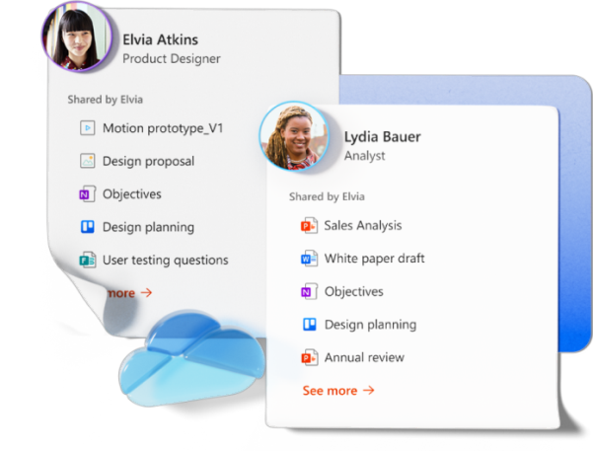
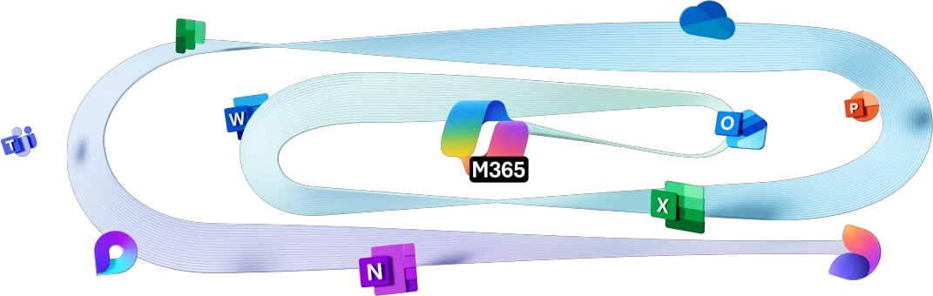
Office 365 management
Empower your organization with Microsoft 365 Copilot Chat for enhanced
productivity, creativity, and enterprise-grade data protection
Exordium Networks installs, manages, and supports the full suite of Microsoft subscription
services Tools like Word, Excel, and PowerPoint boost employee productivity; Access,
OneNote, and Outlook enable seamless collaboration

Slide 16
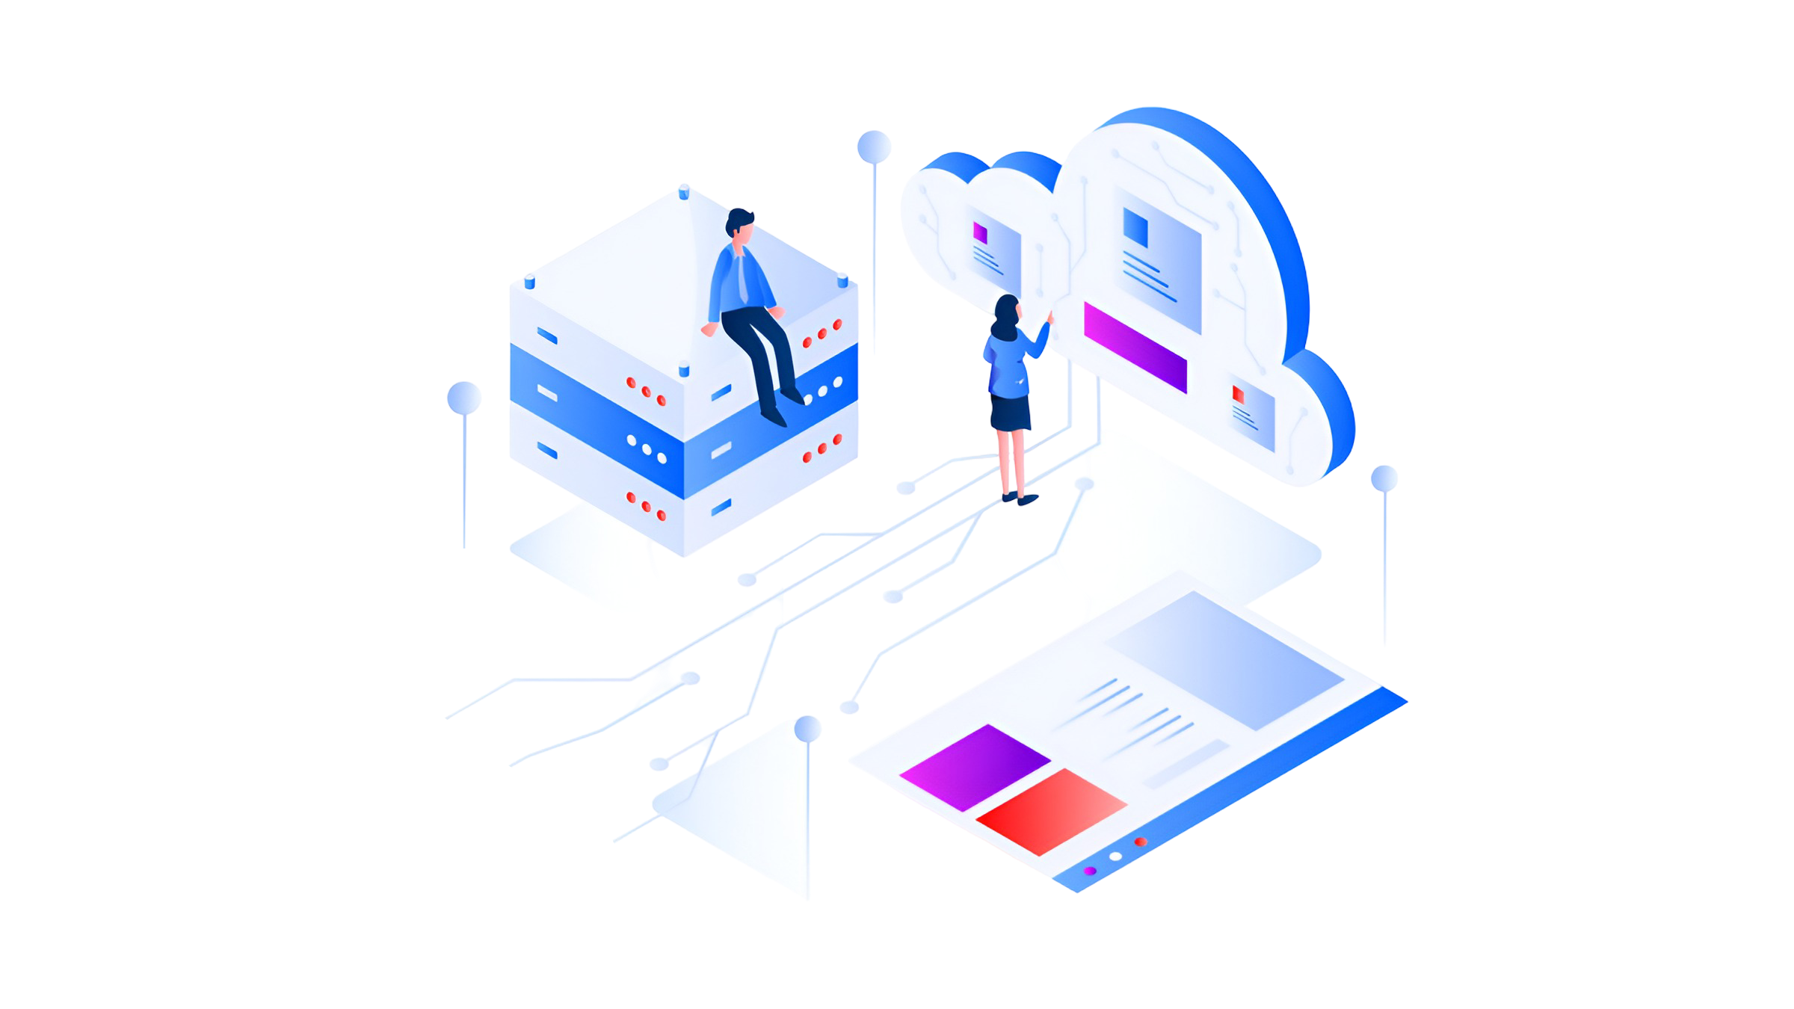
Back Office Management (BOM) Services
Payroll Processing
Salary calculations, overtime, bonuses tatutory deductions, payslip generation,
dispute resolution Generating payslips
Handling payroll disputes or corrections
Master records, attendance, leave, shift tracking
Maintaining employee master records
Attendance & leave management
Tracking shifts, rosters, overtime
Payroll compliance, tax returns, social security,
audit documentation
Ensuring payroll complies with local labour laws
Filing tax returns
Managing social security contributions
Maintaining audit documentation

Slide 17
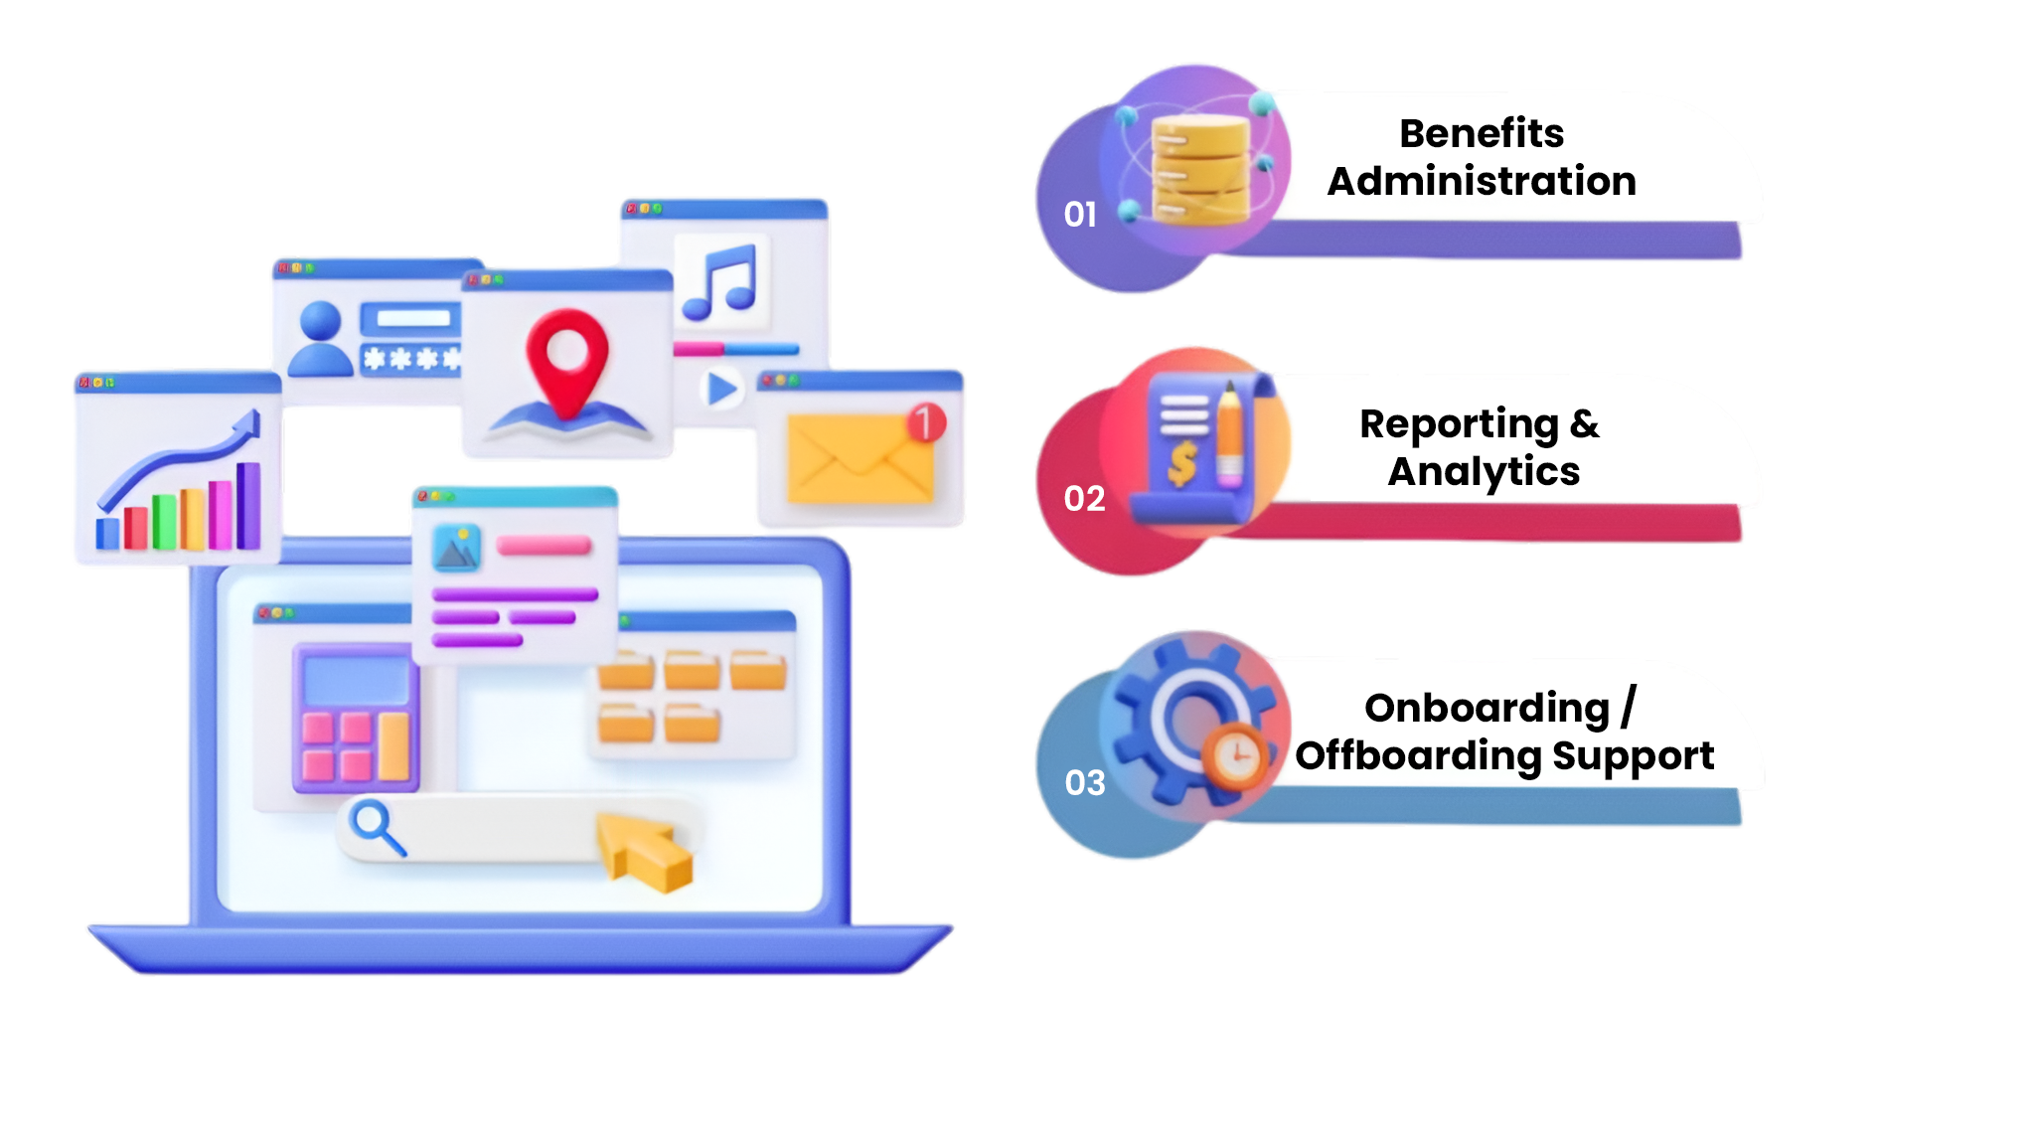
1
3
Benefits Administration
Health insurance
Pension schemes
Reimbursements
Allowances
On boarding / Offboarding Support
Employee onboarding paperwork
Exit settlements
Final pay check calculations
Reporting & Analytics
Payroll reports
Cost- centre analysis
HR metrics dashboards
2

Slide 18

Ready to Future-Proof Your Business?
Partner with Exordium Networks for a smarter, safer,
and more innovative experience.
Contact us to discover tailored IT solutions that drive your organization forward and to learn more about our tailored IT solutions.

Slide 19



exordium-aisolutions.com
Thank You
PLOT NO 20, HUDA TECHNO,
ENCLAVE HITECH CITY, Madhapur,Hyderabad, Telangana, India, 500081.
exordium-aisolutions.com
info@exordium-aisolutions.com

